Slide 1
Patient Database Management System Using BlockChain
2010030526 – D.Dedeepya
2010030530 – K.SriTeja
Guided by
Lalitha Surya Kumari mam’m

Slide 2
Table of Contents
Introduction
Documentation
Hardware and Software Requirements
Git-hub setup

Slide 3
Introduction
This framework employs the smart contract to establish a medical record management system to ensure the privacy of patients. Moreover, the blockchain technique accelerates the medical record or information exchange such that the cost of human resource is significant reduced.
All patients can manage their individual medical records and information easily in the different hospitals and clinics. They also have the privilege to deal with and authorize personal medicalrecords in the proposed management framework.

Slide 4
Literature Review
Author : BessemZaabar,OmarCheikhrouhou,FaisalJamil,Meryem Ammi,Mohamed Abid
Published on : 9 December 2021
Title: HealthBlock: A secure blockchain-based healthcare data management system
Abstract: In this work, we have proposed the HealthBlock system that is a blockchain-based system for a decentralized healthcare management system. The proposed system uses Blockchain technology integrated with healthcare IoT devices to build an efficient and secure RPM and EHR management. The architecture of the proposed system is derived from exploiting the decentralized storage concept and a permissioned blockchain network as an access control mechanism to monitor the patient’s vital signs
Pros: This technology is used to ensure EHR management, access control, data integrity, audit, and interoperability.
Cons: patient health data could be either collected from wearable sensors or manually introduced by users.
link : https://www.sciencedirect.com/science/article/abs/pii/S1389128621004382#

Slide 5
Author : Dimiter V. Dimitrov
Published on : 2019 Jan 31
Title : Blockchain Applications for Healthcare Data Management
Abstract : This study aimed to provide an overview of the potential for blockchain technology in the healthcare system. The review covers technological topics from storing medical records in blockchains through patient personal data ownership and mobile apps for patient outreach.
We performed a preliminary survey to fill the gap that exists between purely technically focused manuscripts about blockchains, on the one hand, and the literature that is mostly concerned with marketing discussions about their expected economic impact on the other hand.
Pros : fast, simple, and seamless interaction between data providers, including patients themselves.
they increase the security and privacy of data; data is encrypted in blockchains and can only be decrypted with the patient's private key.
cons: if the network is infiltrated by a malicious party, there is no practical way to read patient data.

Slide 6
Authors:-Hui Li Wang, Shao-I Chu, Jiun-Han Yan, Yu-Jung Huang, I-Yueh Fang, Shu Ya Pan, Wei-Cheng Lin, Chao-Tien Hsu, Chih-Lung Hung, Tzung-Ching Lin and Te-Tsun Shen
Published on:-October 30th, 2020
Title:- Blockchain-Based Medical Record Management with Biofeedback Information
Abstract:- Instead of using the traditional centralized databases, the Ethereum-based blockchain is applied to our designed system framework of medical record management to ensure the security of data. The medical records are stored within individual nodes in the blockchain networks by utilizing the smart contracts. The automatic smart contracts for the administration procedure are also designed with an aim to reducing the waste of human resource and speeding up the medical process.
Pros:- medical records are stored to guarantee data security, privacy and integrity.
https://www.intechopen.com/chapters/73842

Slide 7
Hardware and Software Requirements
Hardware Requirements:-
processor – intel core i7
Ram – 4GB
Hard Disk – 1TB
Software Requirements:-
Remix ide
solidity
Html

Slide 8
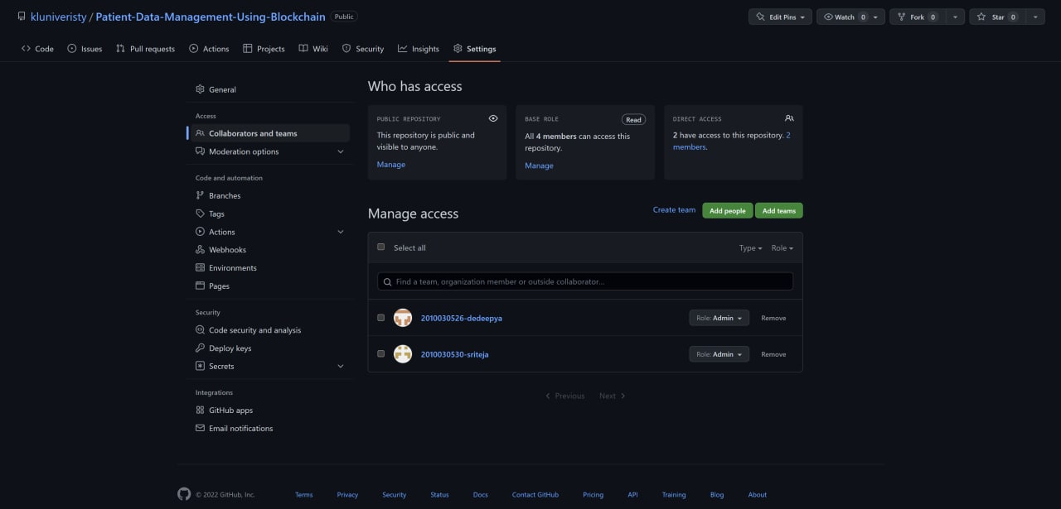
GitHub Setup

Slide 9
Work Allocation
Implementation and back end- Sriteja
Techniques and front end-Dedeepya

